Slide 1
-Task1-
Exploratory Data Analysis
By Oumaima BENTAKHOU

Slide 2
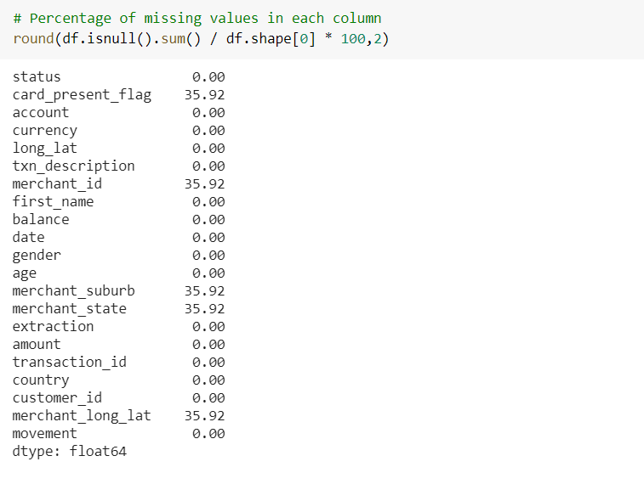
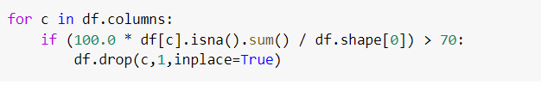
Data Cleaning
1 - Missing Values
we constate that there is a lot of missing data (>90%) in columns bpay_biller_code and merchant_code so it is better to delete all columns that contains more than 70% of missing values

Slide 3
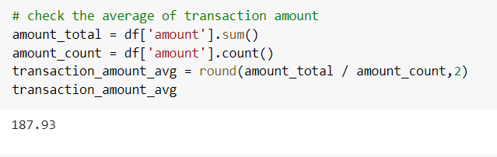
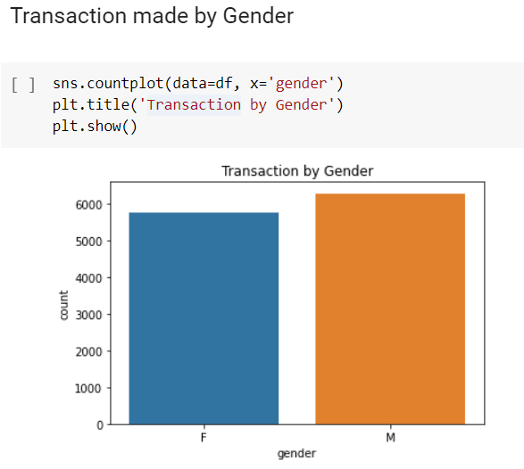
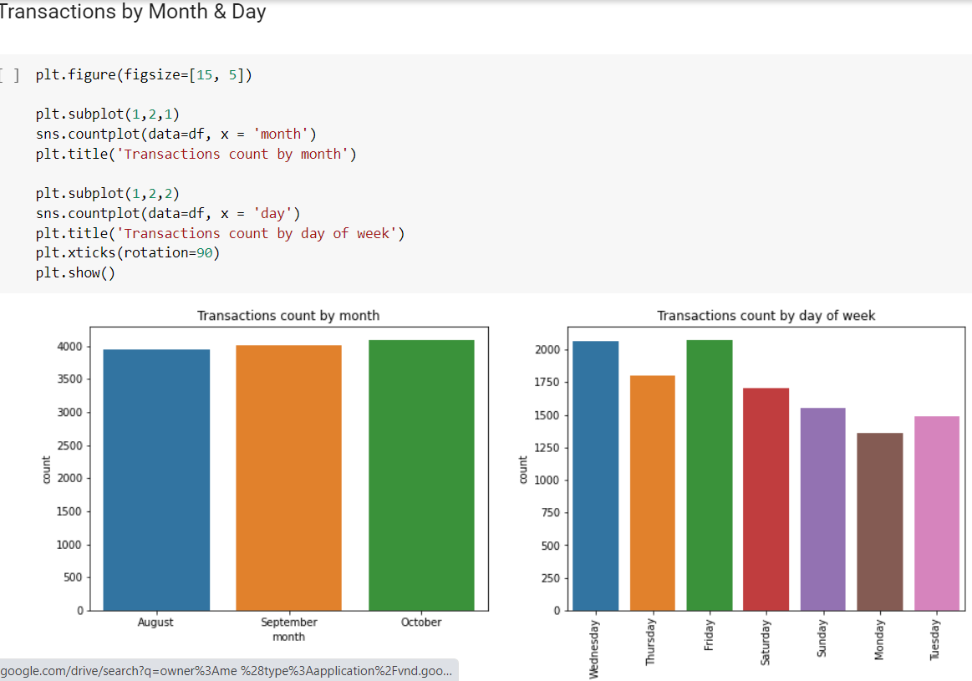
Data Exploration

Slide 4
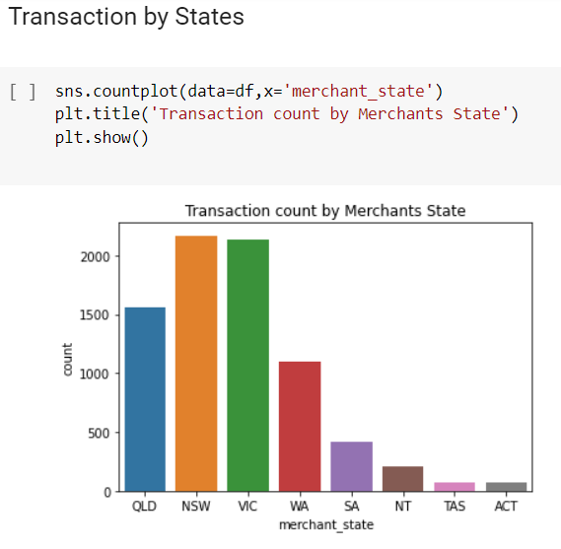
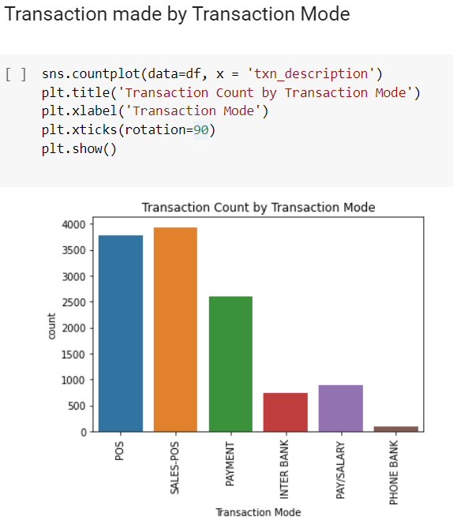

Slide 5
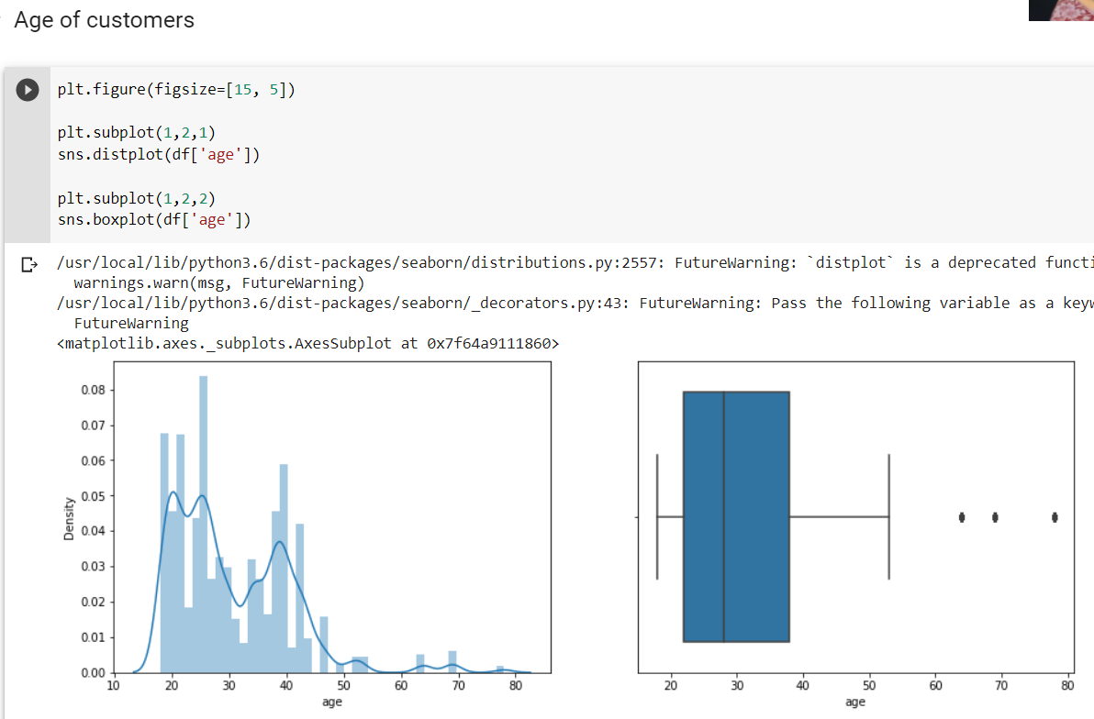

Slide 6
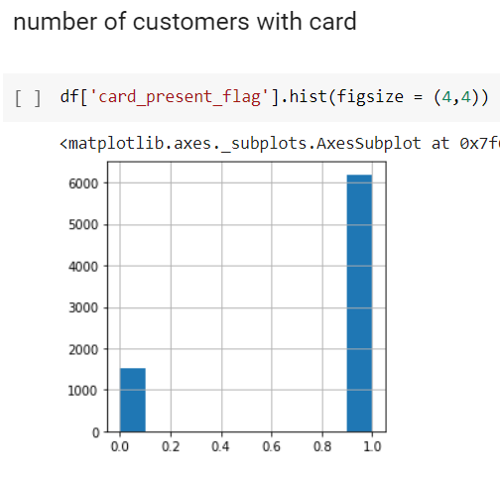
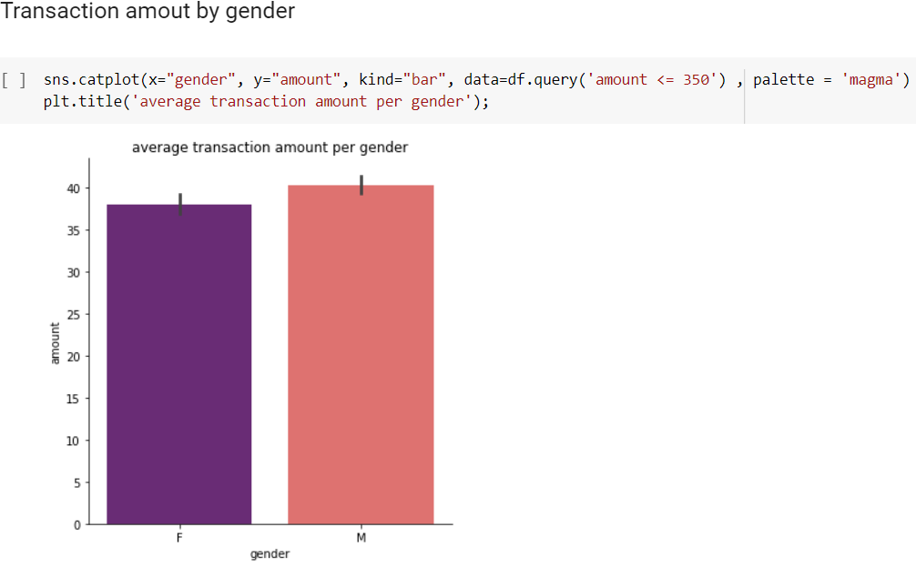

Slide 7
Insights :
There is no big difference in customers gender
There isn’t a huge difference in count of transactions by months, but we can say that by days Wednesday and Friday are the highest
SALES_POS and POS are the transactions mode with the highest count of transactions
The age of customers is mainly between 20 and 40 years old
Plus than 80% of customers have present card

